Slide 1

Team Name – Runtime Terrors
Track – OPEN INNOVATION

Slide 2
Problem ; Foodies often have doubts about the hygiene and Statement quality of food they have ordered online/offline after the pandemic hitted us hard and to provide work to the underrated chefs
To overcome this problem we have come up with an idea of connecting the local chefs and the elite chefs with a social platform called " Chef à la carte ". Foodies can now hire a chef for a day or couple of hours according to their needs and can enjoy the delicious food that is made at their home and that too by a professional. Goodbye to the hygiene problems and goodbye to the limited choices of food.
SOLUTION
Target Audience : The target audience for the beginning is the metropolitan city
residers.
This problem is important to solve as to promote chef culture in the India itself and also to provide the work to the chefs are really good at cooking but doesn’t get enough opportunities. Also, to provide quality and healthy food that’s made at home by professionals

Slide 3
Individualism About Our Idea
Connecting the local and under rated chefs to the modern society through a social platform.
Chefs Specialized in particular cuisine/dish are available separately.
Providing chefs based on the reviews of the consumers. If an elite chef is given bad ratings many a times the chef would be then placed in the category of the basic chef whereas if the basic chef grabs good rating constantly the chef would then be placed in the Elite chef category.
Paid Subscription to unlock the Elite class of chefs in the town.
For Chef and Customer Security we have loaded extra security features on both the website and the mobile app.
Special discount by the help of Referral System.
Loyalty Customer Bonus for the ones who take our service very frequently.
Unique Refund policy in the case of mishap from the side of chef.
All the points mentioned above will be explained in the brief by us during the hours of Hackathon

Slide 4
Technology stack
CSS , HTML , Java-Script and
Django framework

Slide 5


Chef à la Carte
Eat Right, Live Bright

Slide 6

LOGO FOR OUR PLATFORM

Slide 7
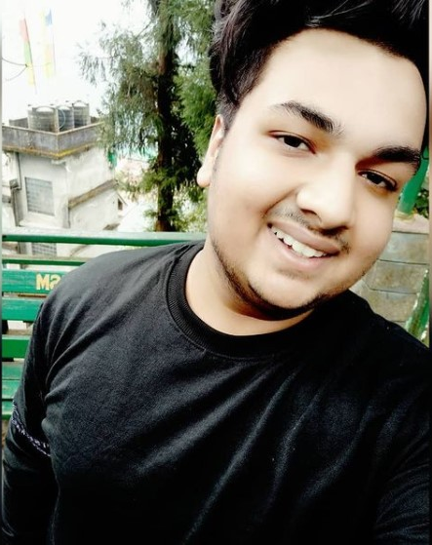
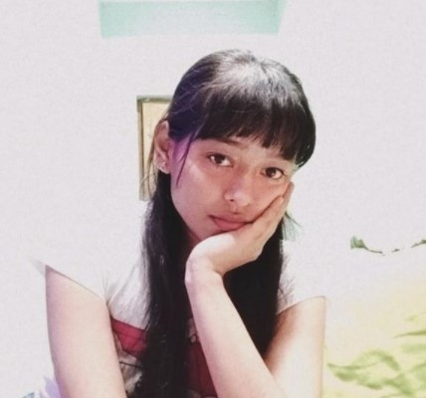
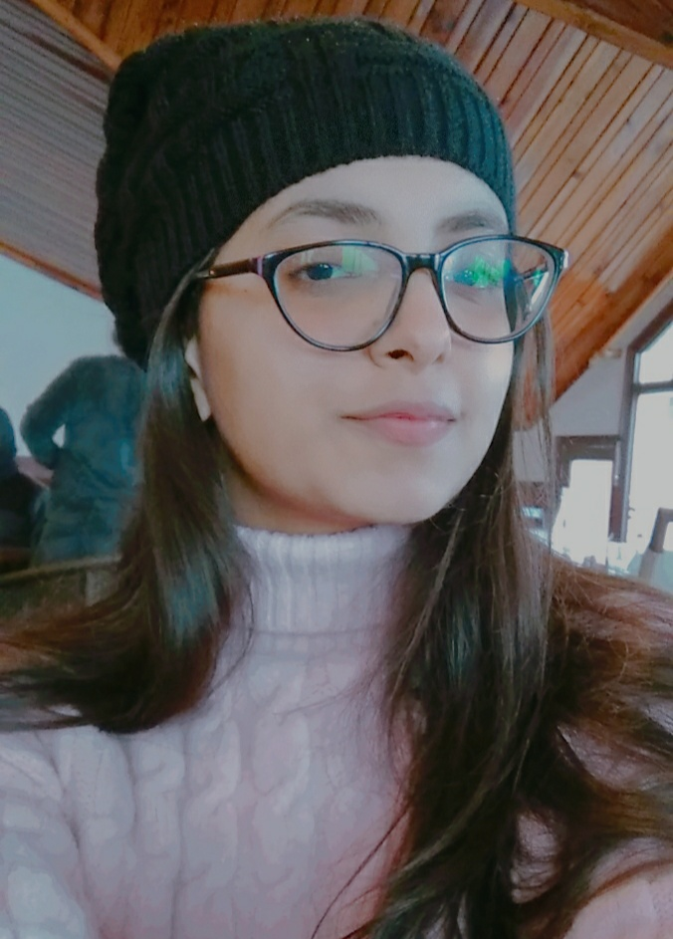
Team Introduction
Hritik Agarwal
Contact – 8209890159
Email id –
hritikagarwal675@gmail.com
Kalyani NA
Contact - 9045248692
Janvi Mittal
Contact - 8448202239
We all are from UPES,Dehradun

